Slide 1

TensoRF： Tensorial Radiance Fields
张量辐射场

Slide 2
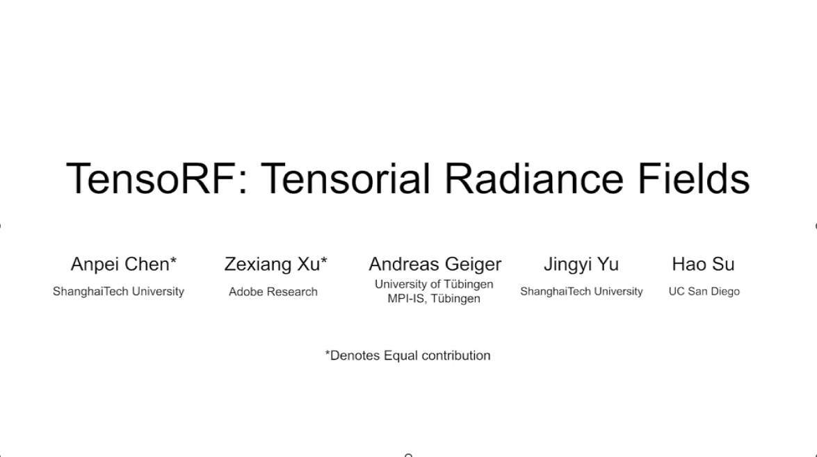

Slide 3
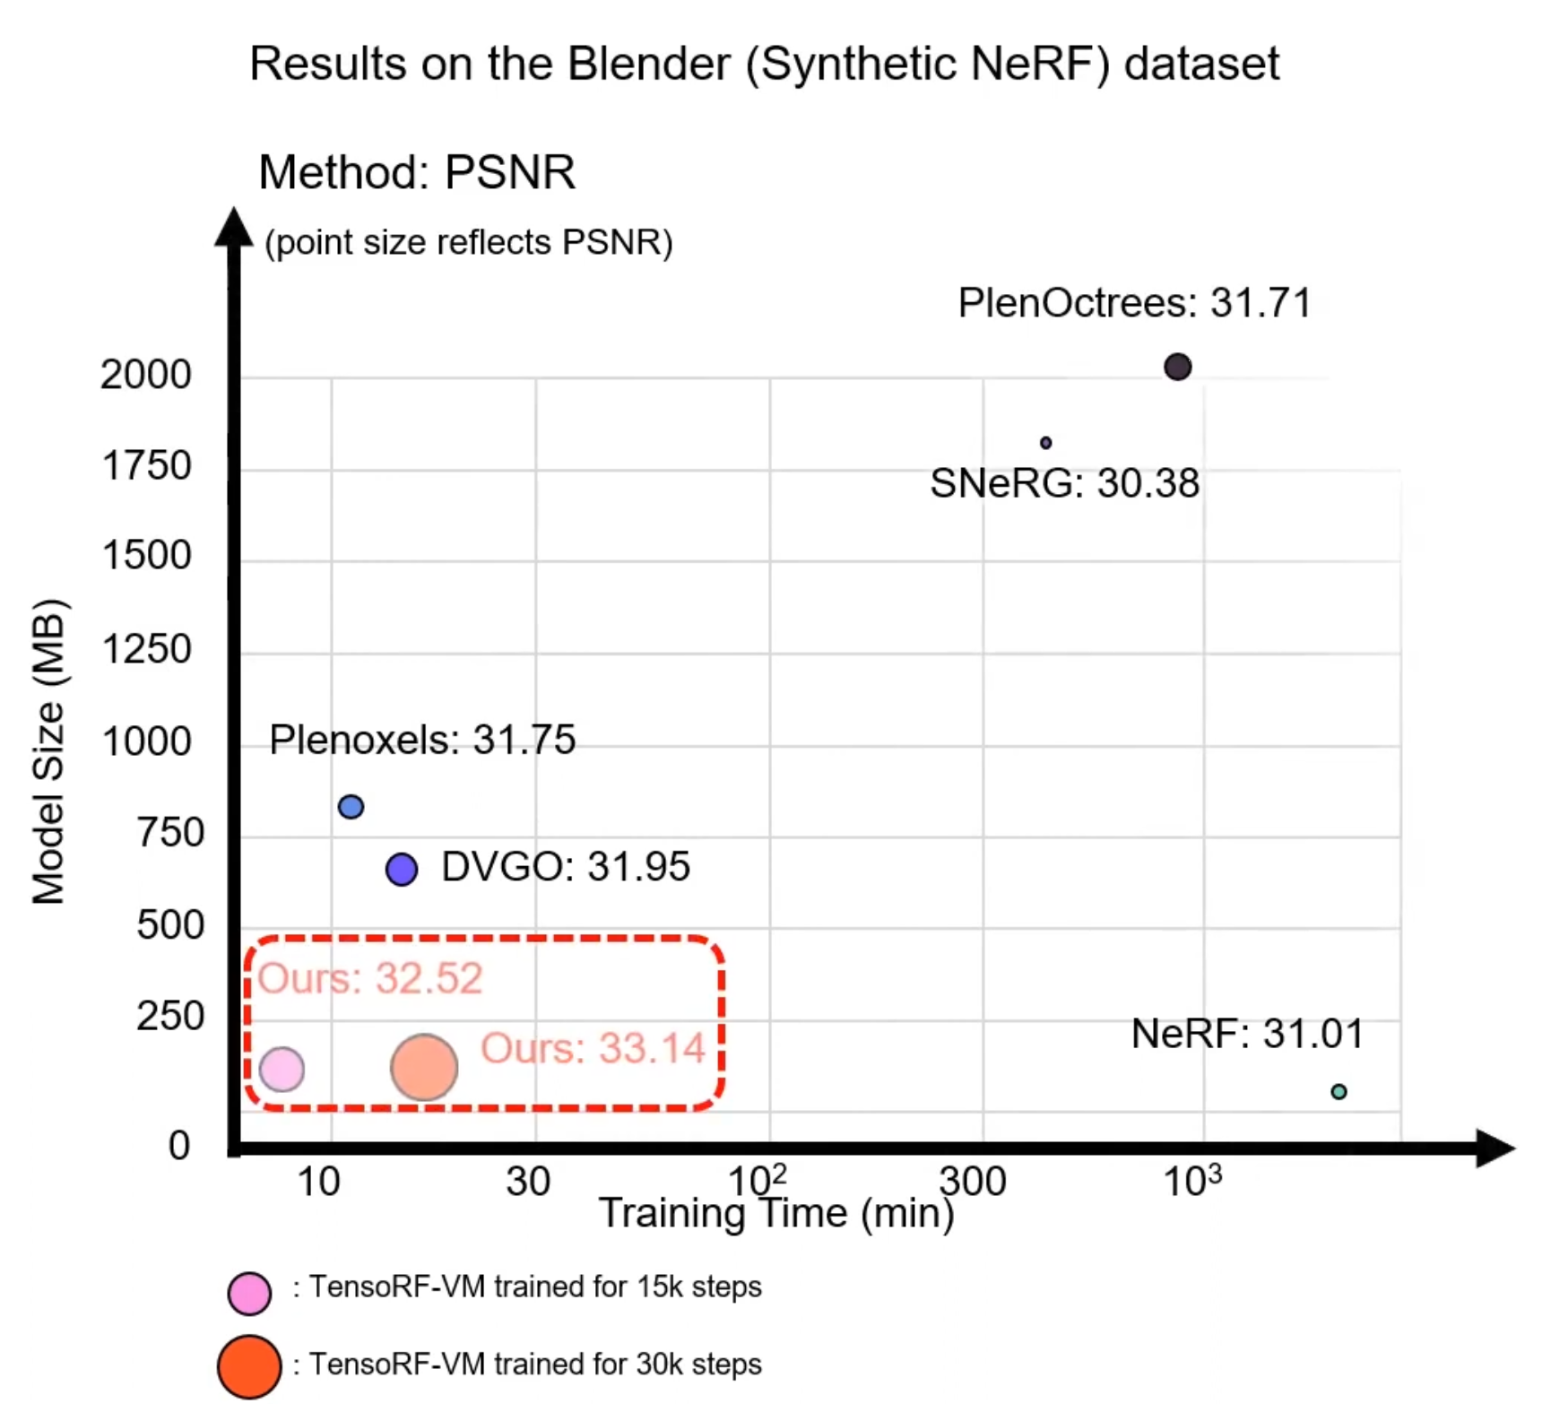
TenoRF
State-of-the-art quality
Fast reconstruction
Compact modeling

Slide 4
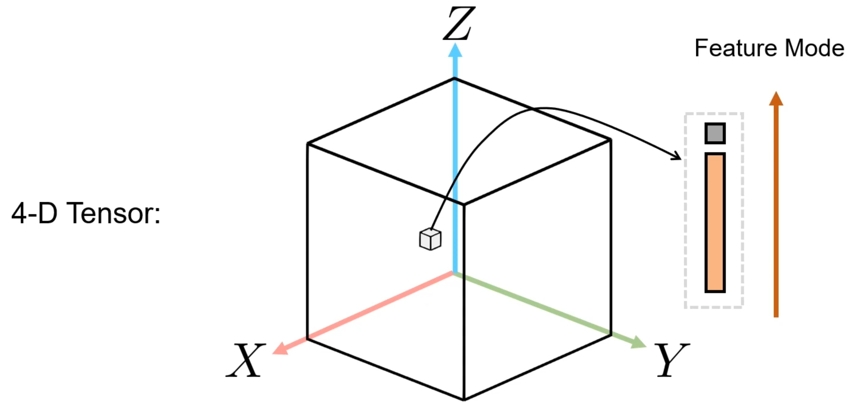
TenoRF

Slide 5
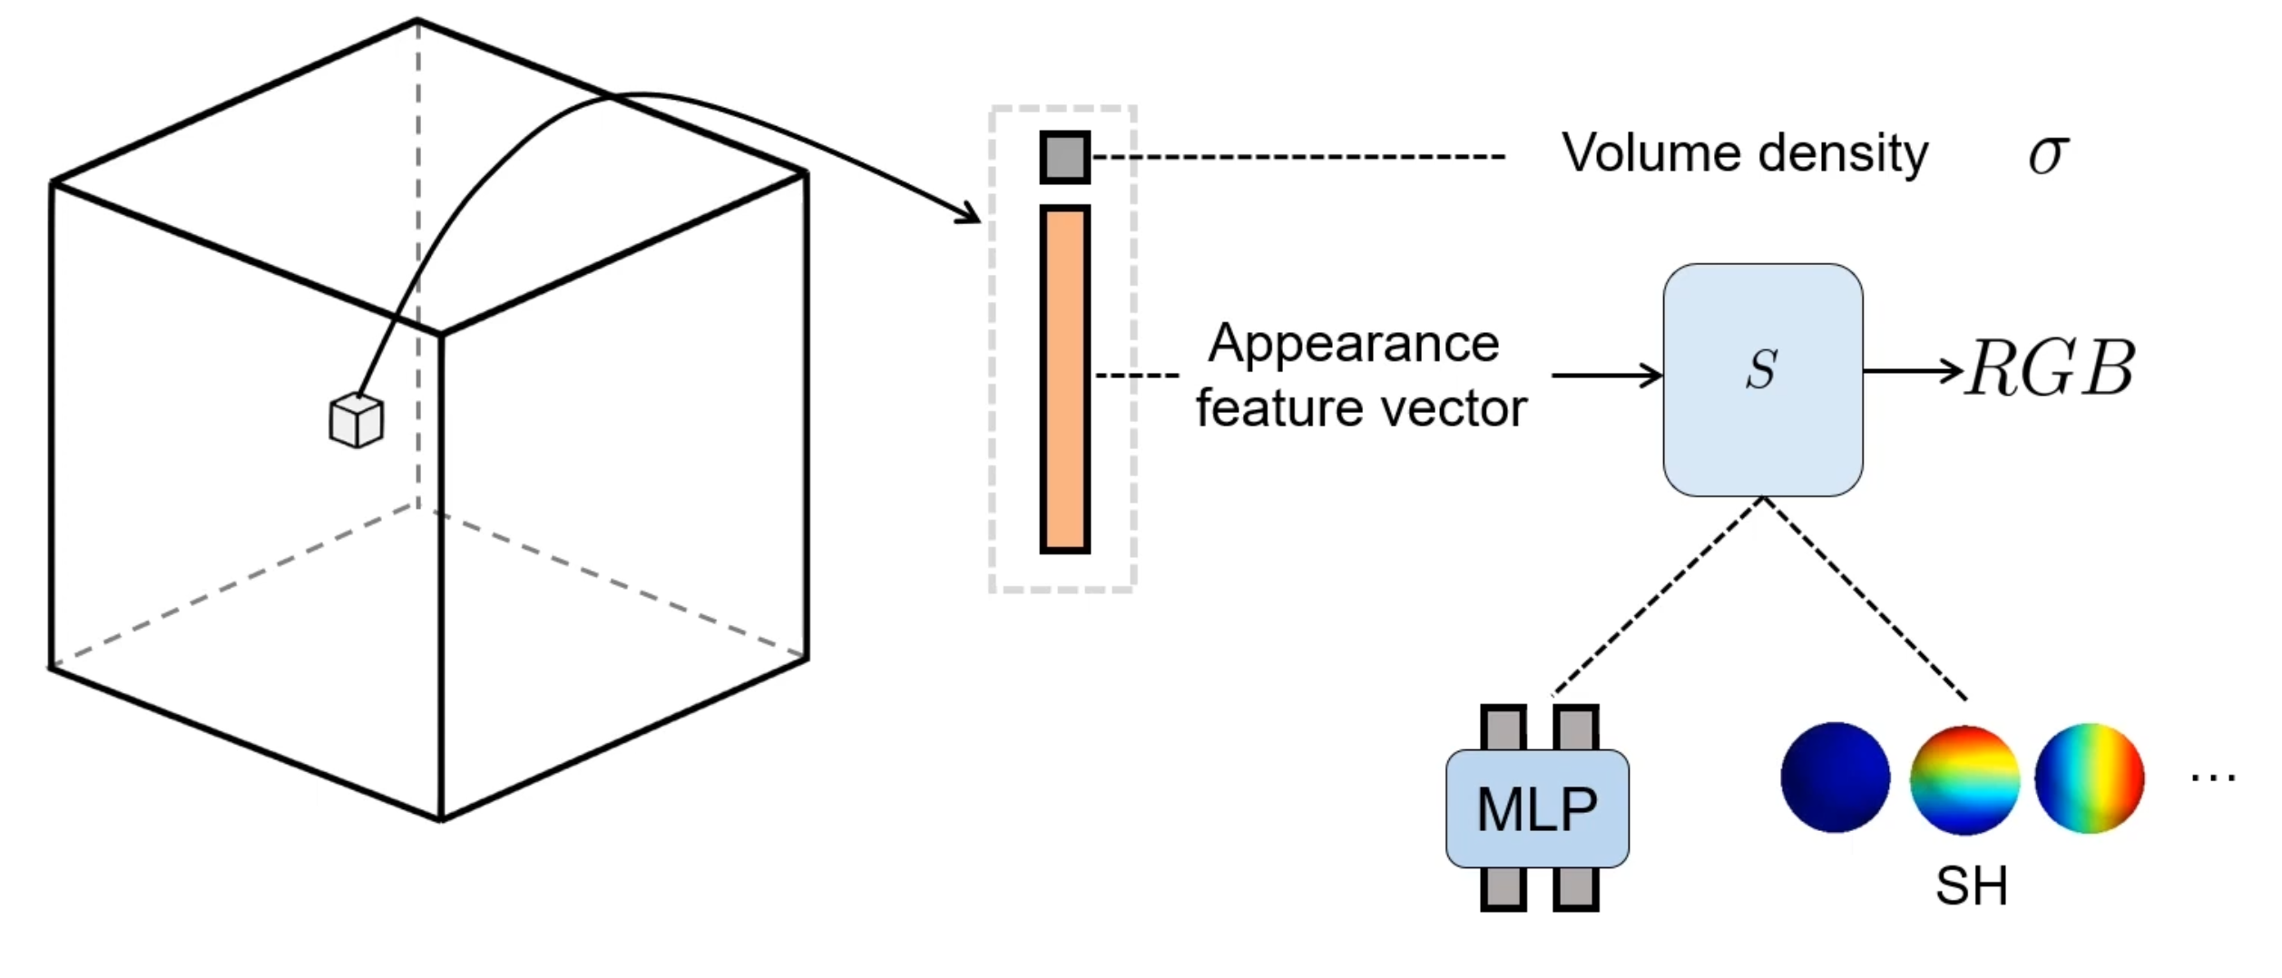
TenoRF

Slide 6
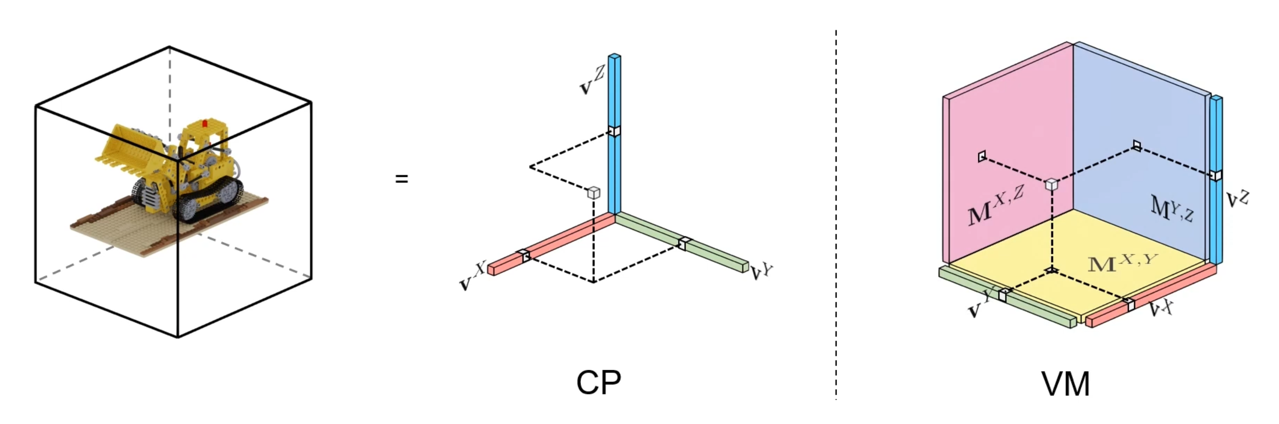
TenoRF

Slide 7
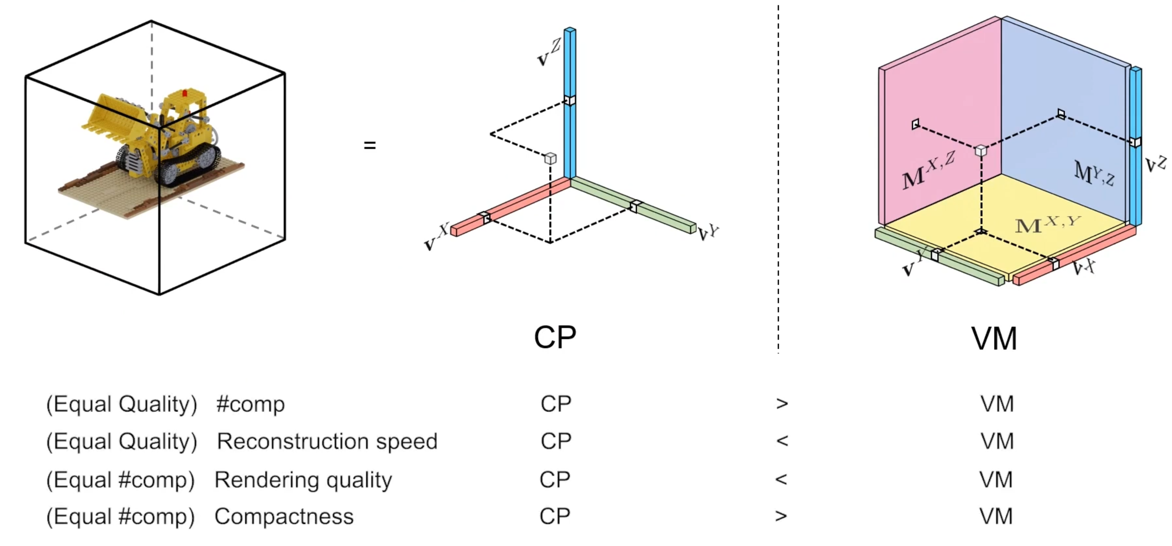
TenoRF

Slide 8
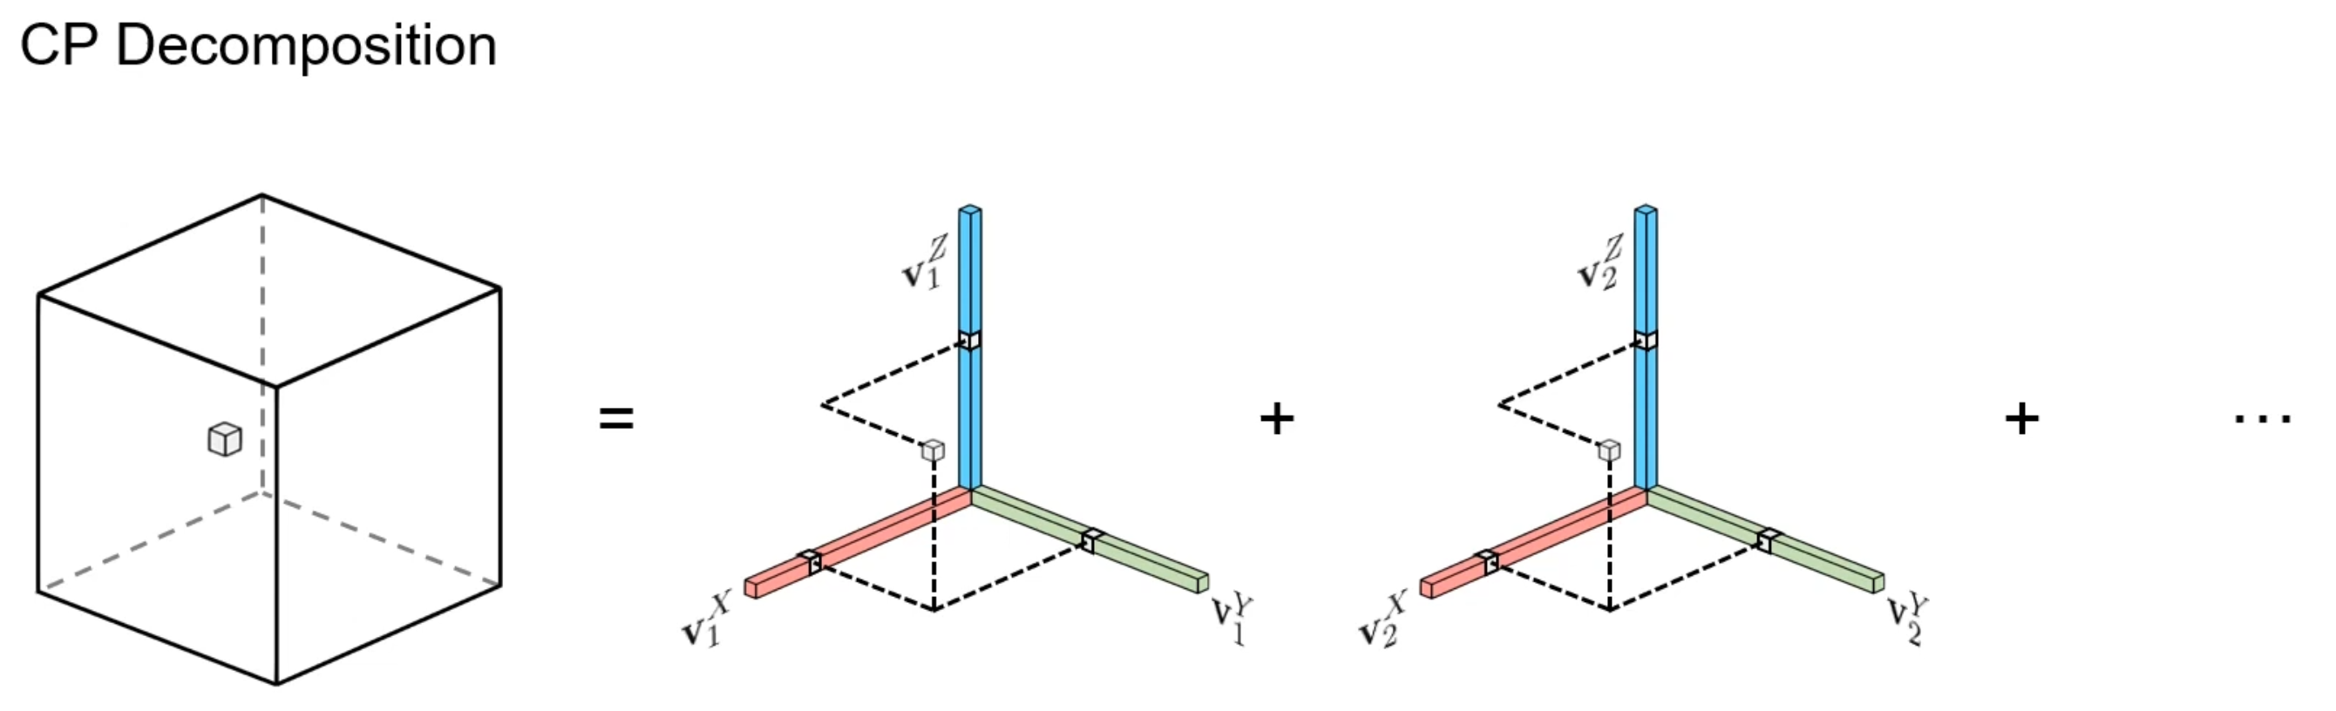
TenoRF

Slide 9
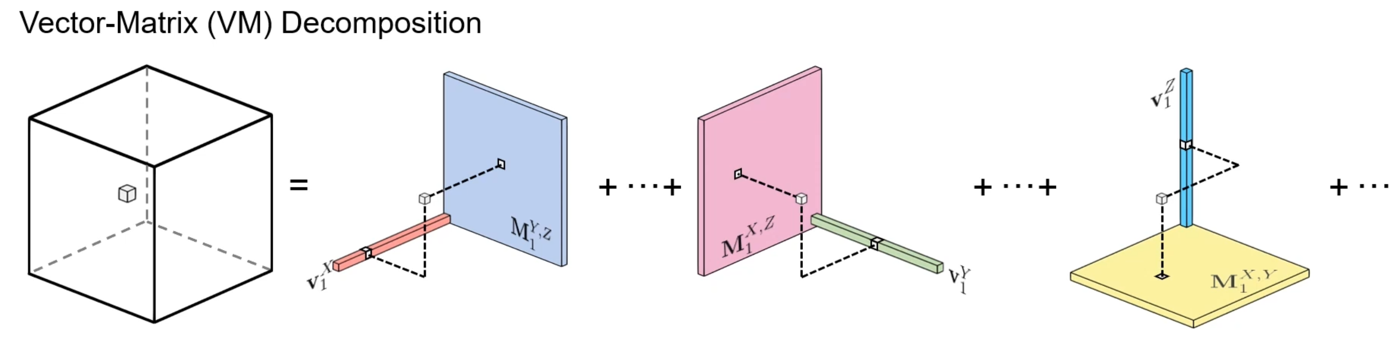
TenoRF

Slide 10
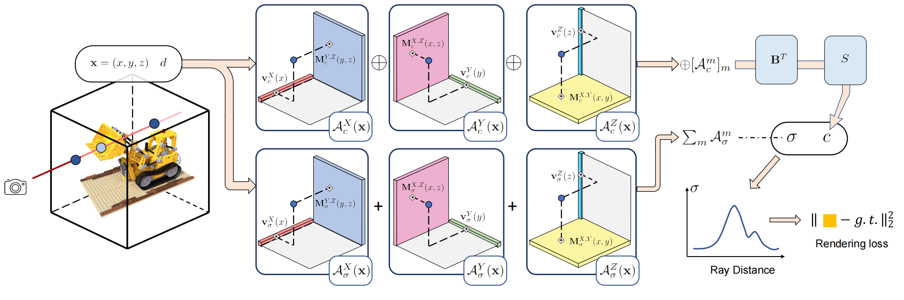
TenoRF

Slide 11
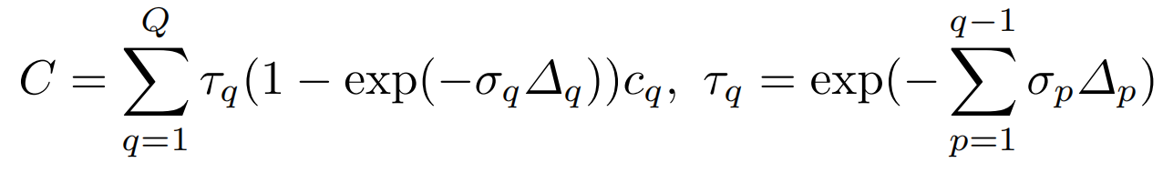
TenoRF

Slide 12
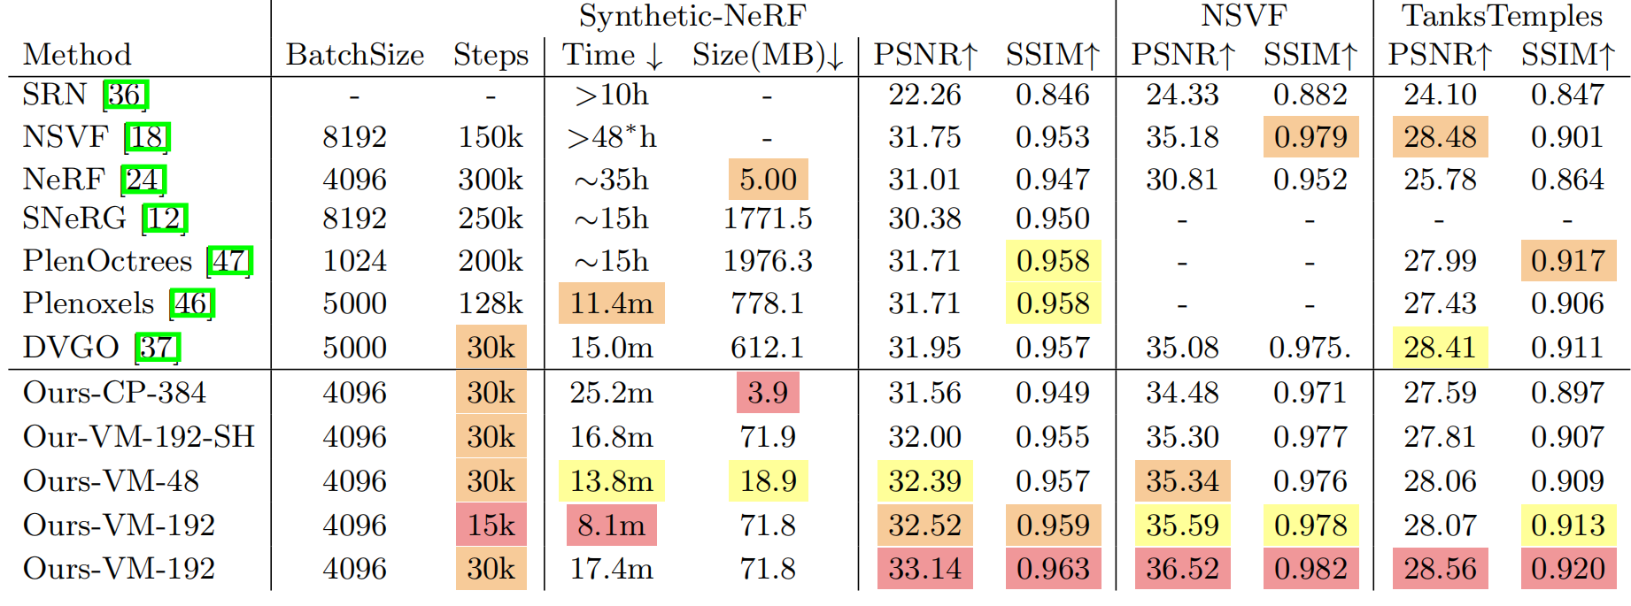
TenoRF

Slide 13
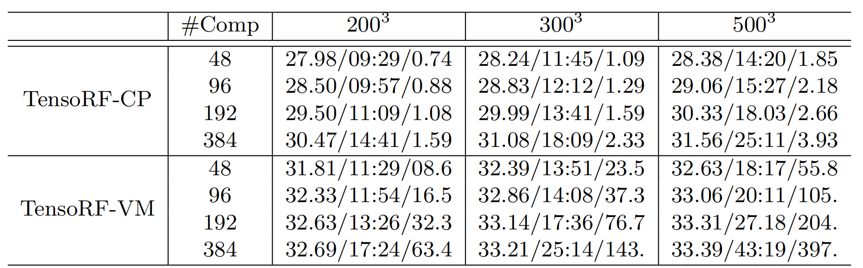
TenoRF

Slide 14
参考：
https://www.kolda.net/publication/TensorReview.pdf (张量分解论文)
https://zhuanlan.zhihu.com/p/302453223 (CP分解）

